Slide 1

An application of hashing: Map-Reduce
Developed by two researchers at Google
Many companies want to process large amounts of data quickly
without purchasing super-computers
Alternative: Split work across several nodes (off-the-shelf machines)
Risk of failures:
What if a node fails during computation?
How many hard-drive failures does Google suffer? ~1 per
minute
hour
day
month

Slide 2
The general map-reduce process
The input is split into chunks
Some nodes run map tasks on one or more chunks
each chunk is converted into a sequence of (key, value) pairs
keys don’t have to be unique
A master node gathers all (key, value) pairs and groups them into lists by key: (k₁, [v₁₁, v₁₂, …]) ; (k₂, [v₂₁, v₂₂, …]) ; …
Some nodes run reduce tasks: given one or more such lists, “reduce” the values in the list
Lastly, the master controller gathers the reduced values to produce the final answer

Slide 3
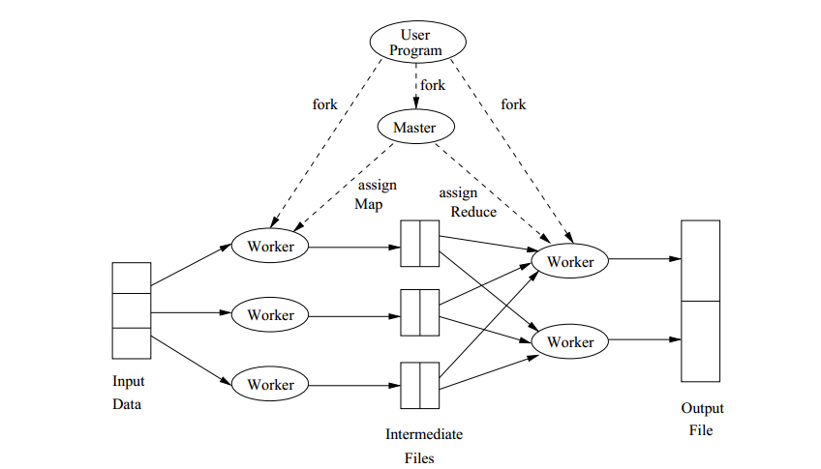
Overview
mappers
reducers

Slide 4
Example 1: Frequency of each word in large files
The chunks are files
Each map task is given one or more files
each file is converted into a sequence of pairs (word, 1)
The master node gathers all the (word, 1) pairs and groups them into lists by key: (w₁, [1, 1, …]) ; (w₂, [1, 1, …]) ; …
Each reduce task is given one or more such lists, and “reduces” the values in the list by adding all the 1’s
Lastly, the master controller gathers the reduced values to produce the final answer: (w₁, c₁) ; (w₂, c₂) ; …

Slide 5
Alternative strategy
If a word w appears m times in a file
the mapper will produce (w, 1), (w, 1), … m times
instead, what if the mapper produced just (w, m)?
Shifts some of the computation from the reducer to the mapper
but also reduces the amount of intermediate data!
original : m × (bitsize(w) + 1) bits
alternative : bitsize(w) + ⎡log₂(m)⎤ bits
Running time dominated by data transfer time between map/reduce nodes and the master
CPUs MUCH faster than the interconnect speed/local HDD rates
If input size totals N bits, key-value pairs total K bits, key-reduced pairs total R bits and the final output totals M bits, then
Communication Cost is O(N + K + R + M)

Slide 6
Example 2: Matrix-vector multiplication
Consider an n × n matrix A whose (i, j)^{th} element is a_{ij}, and an n × 1 vector v
The product Av is an n × 1 vector x where x_{i} =
Assume that vector v fits in each mapper’s memory, but n is very large so that A is stored in a file as a set of triples (i, j, a_{ij}) for non-zero a_{ij}
Each map task is assigned a chunk of the file, and maps (i, j, a_{ij}) to the pair (i, a_{ij}v_{j})
Each reduce task combines lists (i, [x_{i1}, x_{i2}, …]) into (i, x_{i1} + x_{i2} + …)
the master thread assembles and outputs vector x

Slide 7
Communication Cost Analysis for Example 2
Input: n × n matrix A whose m non-zero elements a_{ij} are stored as triples (i, j, a_{ij}), and an n × 1 vector v (each mapper has a RAM copy)
Output: product, an n × 1 vector x
Assume that each matrix/vector element has size b
N is O(m(b + log n))
K is O(m(b + log n))
R is O(n(b + log n))
M is O(nb)
Communication Cost is O((m + n)(b + log n))
Note: m is O(n²) but m << n² for sparse matrices

Slide 8
A variation
Consider the same situation as before, but suppose that n is so large that v cannot fit into memory
v stored in a file as n pairs (j, v_{j})
Consider the following map-reduce algorithm:
map each triple (i, j, a_{ij}) to (i, (j, a_{ij}))
map each pair (j, v_{j}) to n pairs: (i, (j, v_{j})) for every i
in order to reduce (i, L_{i}), find pairs (j, a_{ij}) and (j, v_{j}) in L_{i}, compute a_{ij}v_{j}, add these up to produce the sum x_{i} and lastly emit (i, x_{i})
Note: The list L_{i} may not fit in memory, in which case the above step would need to be performed as another map-reduce!
the master thread assembles and outputs vector x
Analyze the communication cost

Slide 9
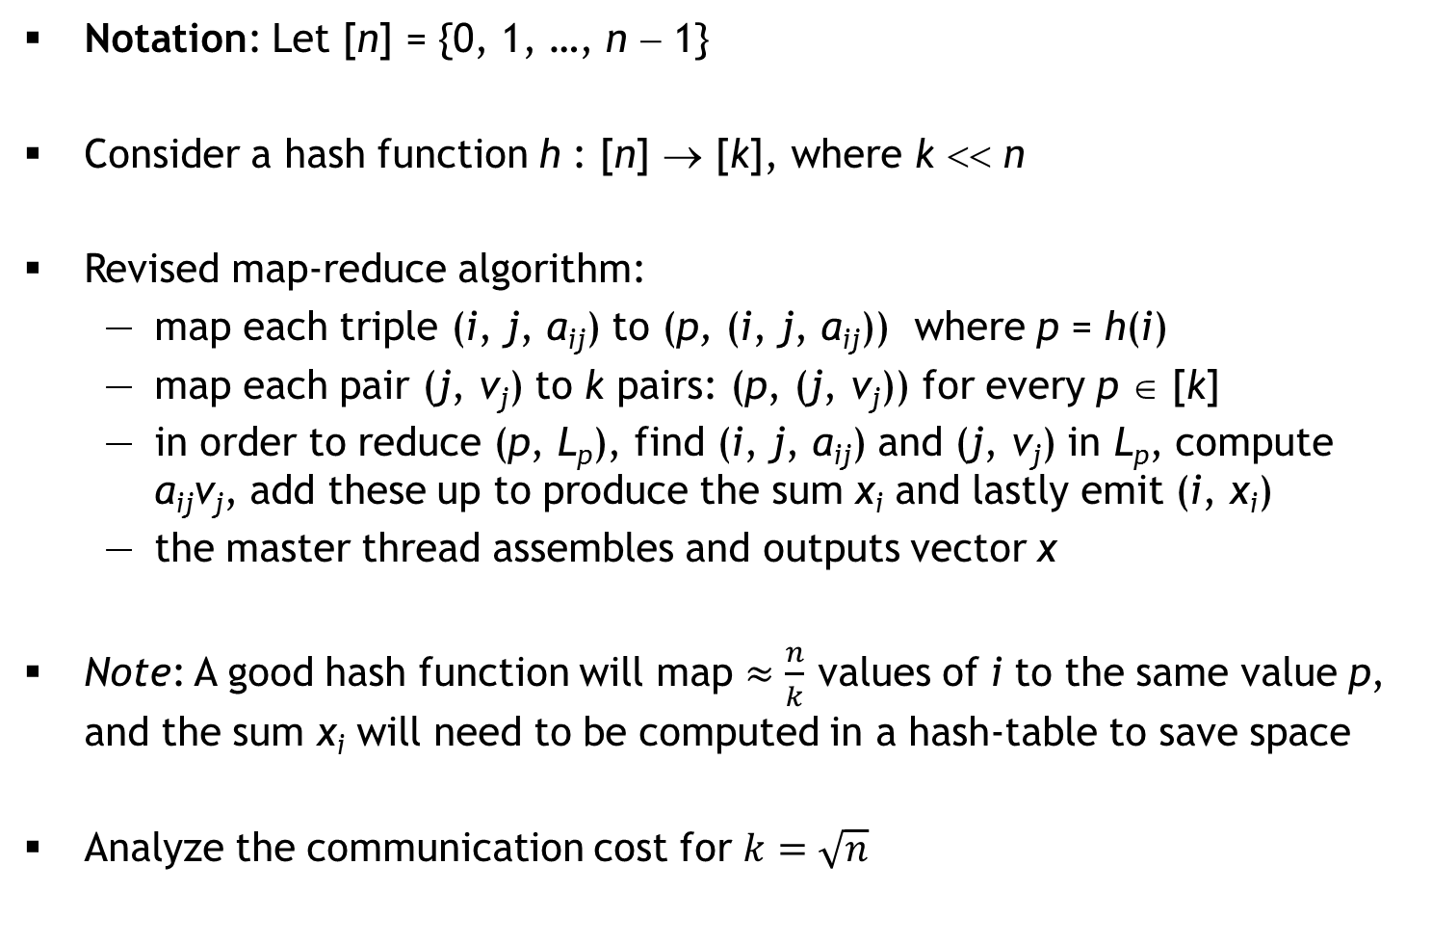
An improvement using hashing
Notation: Let [n] = {0, 1, …, n − 1}
Consider a hash function h : [n] → [k], where k << n
Revised map-reduce algorithm:
map each triple (i, j, a_{ij}) to (p, (i, j, a_{ij})) where p = h(i)
map each pair (j, v_{j}) to k pairs: (p, (j, v_{j})) for every p ∈ [k]
in order to reduce (p, L_{p}), find (i, j, a_{ij}) and (j, v_{j}) in L_{p}, compute a_{ij}v_{j}, add these up to produce the sum x_{i} and lastly emit (i, x_{i})
the master thread assembles and outputs vector x
Note: A good hash function will map $≈\frac{n}{k}$ values of i to the same value p, and the sum x_{i} will need to be computed in a hash-table to save space
Analyze the communication cost for $k=\sqrt{n}$
X = empty_hash()
for each (i, j, a_{ij}) in L_{p}
for each (j, v_{j}) in L_{p} {
if X contains value x_{i} for key i
insert (i, x_{i} + a_{ij}*v_{j}) into X
else
insert (i, a_{ij}*v_{j}) into X
}
emit all (i, x_{i}) pairs in X

